Slide 1
MISA – MRM V2
Integrated Technical Review (ITR)
July 21, 2010

Slide 2
Agenda
Review Scope and Objectives of the ITR
Better understand Business User needs for performance analysis requirements
Review revised MRM V2 Model
  MISA Delivery Platform
  Governance and Role review
Summarize Tool Assessment
  Rational (Reqpro based)
  IBM Smart Architecture and Engineering model (Eclipse, RSx, UML based)
  System Architect and Focal Point
  Cognos and SPSS
  Collaboration & Repository (Quickr)
Demo System Architect and Focal Point Strategic Enterprise Planning demo
Next Steps

Slide 3
Integrated Technical Review
  Business Direction/Drivers
    Original RFI and the subsequent IBVA
    Determine stakeholder roles
      MISA
      IBM
      Subscribers (municipalities)
  Review Functional Requirements Matrix
    Municipal Reference Model (MRM), V2-Rel 1 Business Use Cases, Tasks, Operations, Features and Meta Model Specifications (Draft V19, Dec 2009)
    Best Practice/Assets types
  Use Case (s)
    IBVA Business Use Cases (approx. 5)
    System Use Cases / Task Specifications (approx. 21)
    Other?
  Understand other requirements
    Non-Functional
    Standards
  Build Architecture Overview
    Logical View
    Key Architectural Decisions
    Security View (Workshop)
    Service Management View (Workshop)
    Reporting Architecture & Design
    Position Tools
  Position IBM Tool Alternatives
    MISA plug-in options
  Validate using 4 Business Scenario’s
    Manage MRM Models (Meta Model and Reference Model)
    Manage (Add / Delete) Municipal Subscriptions
    Manage “My Municipality” Participation in MRM V2 Program
    Organizational Design and Restructuring

Slide 4
Objectives - Coherent Government by design
If we really want:
  to move to a “whole of government” approach,
  seamless, citizen-centred services,
  legislation, regulations and policies designed rather than crafted,
  alignment, integration, interoperability, etc. in our business systems,
  to do more with less
We really need:
  a consistent and more formal business design capability based on a common language and set of rules for using it to create better descriptions of what we want (e.g. more coherent ones). A pan-Canadian standard along these lines will enable any conceivable government line-of-business (and inter-collaborations thereof) to better:
    interpret and clarify their missions, strategies, outcomes, etc.
    accurately depict or map how they work (and how they can work together),
    discover opportunities for business improvements,
    support their planning and successful implementation.

Slide 5






Evolve
Before
Defaults to
Paper
Assets
Business & Users
Implementation
Pictures & Documents
Fund
Hand off
Requirements
Governed
Confusion
Leverage
tools aligned
to a Roles
usability
& integration
needs
After
Business & Users
Business Architecture
Implementation
Impact Analysis
Fund
Publish
Requirements
Governed,
Asset Management,
Reuse
Acceleration!
Code, Scripts,
Traceability,
Accuracy
Instrumented (KPIs) Interconnected (traceability) Intelligent (acceleration!)

Slide 6
The Municipal Reference Model Version 2 (MRM v2)
MRM v2 Goal: to create a Tool (Product, Service) that will help municipal governments describe their vision, goals, objectives, programs, services and performance metrics.
…in a standard way
…using precise definitions and concepts accepted and adopted by all governments in Canada
…with tools and templates to help you create the descriptions of the municipality
…with user guides and training material to help create and use these descriptions for a range of municipal purposes
…with a repository where these descriptions can be saved
…repository pre-populated with a generic set of service descriptions that may be provided to any municipality in Canada
…repository pre-populated with specific descriptions (models) created by other municipalities
…with tools that allow for the analysis and comparison of such descriptions
…and with a collaboration space that allows ideas to be shared on how these tools are being used in participating municipalities
In short:
A powerful Authoritative Service Catalogue that all Municipalities can use and share.

Slide 7
Model Driven Business / IT Strategy and Design
(Re-) Use & Develop Models
Business
Drivers
Business Analyst
Service/Data
Analyst
Service/Data
Designer
Integration/Data
Developer
IBM Industry
Models
Define Project Scope
Analyze Processes
Analyze Services
Design Services
Design Processes
Analyze Data
Define Logical Data Model
Define Physical Data Models
Define Datastores
Govern & Manage Enterprise Model Development
Propagate Enterprise Models
(Re-) Use & Develop Models
Harvest Project Models
Identify and Validate Changes
Version Enterprise Models
Model
Manager
Govern & Manage Enterprise Model Assets
Asset
Manager
Govern & Manage Model Development
Promote Enterprise Model
Publish Model Assets
Publish Derivative Assets

Slide 8
Model Driven Business / IT Strategy and Design
(Re-) Use & Develop Models
Business
Drivers
Business User
Business Analyst
Service Analyst
Resource Planner
IBM Industry
Models
Define Project Scope
Analyze Program
Analyze Services
Analyze Processes
Analyze Resources
Analyze Goals & Objectives
Analyze Capabilities
Supporting Services
Strategic Planning
Govern & Manage Enterprise Model Development
Propagate Reference Models
(Re-) Use & Develop Models
Harvest Project Models
Identify and Validate Changes
Version Municipal Models
Model
Manager
Govern & Manage Enterprise Model Assets
Asset
Manager
Govern & Manage Model Development
Promote Enterprise Model
Publish Model Assets
Publish Derivative Assets

Slide 9

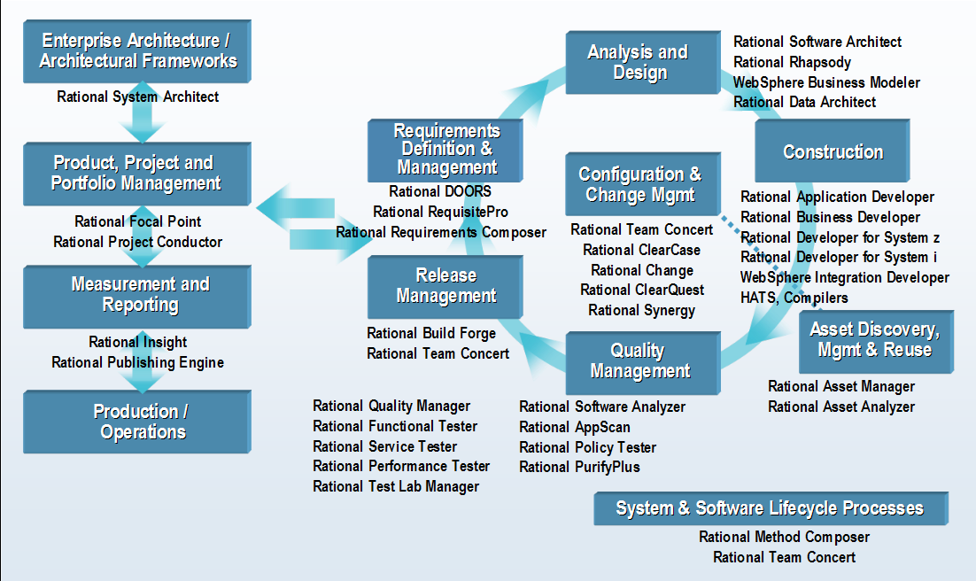

Slide 10
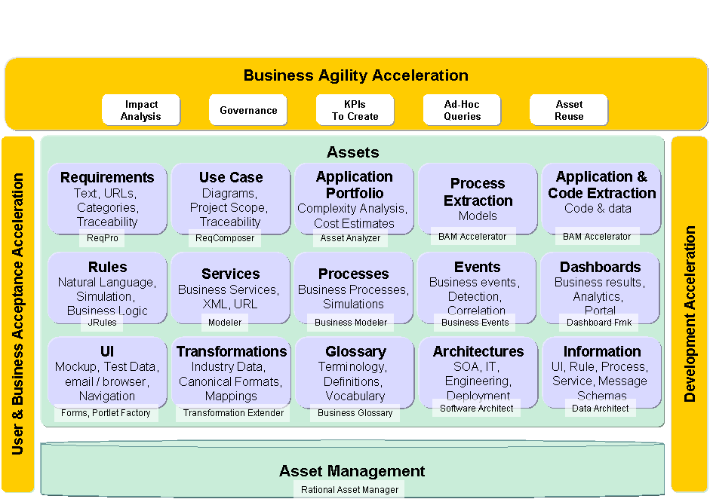
Recent IBM announcement - Smarter Architecture & Engineering (RSx and RAM based)
Notes:
ReqPro & Requirements Composer
This “Must” …
Links to other assets
Asset Management Repository
Taxonomy
Search
Report
Governance
Software Architect
Business Architecture
UML
Traceability
Modeler
Business Processes
Publishing Server
Simulator
Business Rules
Externalize Logic
Rules Server
Forms
Email UI to Users
Integrate with Web 2.0 and Portal
Portlet Factory
Assemble Forms and Portlets
Business Events
What happens over time?
Visual Portlets
Business Spaces
Integrates UI for Business Architecture
Runtime Results
Iwidgets
Data Architect
Logical Information Model
Asset Analyzer
Legacy analysis
Complexity Analysis

Slide 12
Business User needs for performance analysis
1
Business Intelligence
2
Financial Performance & Strategy Management
3
Advanced Analytics
4
Analytic Applications
Monitoring & measuring mission performance to ensure the best outcomes.
Financial and operational performance tied to attaining mission objectives.
Predictive models, forecasting & “what-if” scenarios for refining finance and operations to deliver mission objectives.
Analytic applications developed for specific functions to better manage mission outcomes.
Supply Chain Analytics
Workforce Analytics
Financial Performance Analytics
Planning
What-If Scenarios
Forecasting
Predictive Analytics
Financial Reporting
Financial Analysis
Operational & Financial Risk Management
Scorecards
Reporting
Analysis
Senior Executive Level, Managers
Office of Finance, Program Offices
Office of Finance, Program Offices, Administration
Specific Roles (HR, Supply Chain, Finance, Logistics)

Slide 13











Understand want to be able to measuring performance at the functional level using the MRM V2 model and operational data
Information Technology
Budgeting & Finance
Workforce/ HR
Mission Performance
Financial Performance
Operational Performance
Executive Management
Supply Chain
Operations/ Readiness
Services Delivery
Program Execution
Notes:
How do we help? We help by giving governments the ability to measure their performance by helping government leaders answer three fundamental questions: “How are we doing?”, “Why is the trend occurring?, and finally “What should we be doing?” all around defining and executing on the mission of the government organization through strong financial and operational performance strategies at the functional level within a government organization

Slide 14


Position IBM Tools
1
Business Intelligence
2
Financial Performance & Strategy Management
3
Advanced Analytics
4
Analytic Applications
Monitoring & measuring mission performance to ensure the best outcomes.
Financial and operational performance tied to attaining mission objectives.
Predictive models, forecasting & “what-if” scenarios for refining finance and operations to deliver mission objectives.
Analytic applications developed for specific functions to better manage mission outcomes.
Municipal Executive Dashboard
CFO Dashboard for Government
Municipal Performance Scorecard
Analytic Applications for Government
Senior Executive Level, Managers
Office of Finance, Program Offices
Office of Finance, Program Offices, Administration
Specific Roles (HR, Supply Chain, Finance, Logistics)

Slide 15




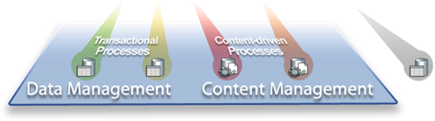
Business Optimization
Business Analytics & Performance Optimization
Cognos, SPSS
IBM Smart Analytics System
Information Integration and Data Warehouse
InfoSphere Information Server
InfoSphere Master Data Management Server
InfoSphere MDM for Product Info Mgmt
InfoSphere Global Name Recognition
InfoSphere Identity Insight Solutions
InfoSphere Warehouse
InfoSphere Balanced Warehouse
InfoSphere Streams
Industry Data & Process Models
Flexible Architecture for Leveraging Existing Investments
solidDB
Optim Solutions
Filenet
Enterprise Content Management
Other Information Sources
Data and Content Management
DB2
Informix
IMS
DB Tools

Slide 16
Expanded context for potential MISA MRM V2 Plug In
IBM Rational Tools
MRM V2
MRM Reference Model
(i.e. Public Safety Program, Fire Rescue Service, etc.)
Rational
System
Architect
MRM Meta-Model
(i.e. Shell Program, Shell Service, etc.)
Industry Plug In’s
IBM Information Management Tools
COGNOS
SPSS

Slide 17
The Municipal Reference Model Version 2 (MRM v2)
MRM v2 Components:
MRM Reference Model
(i.e. Public Safety Program, Fire Rescue Service, etc.)
Customized “My Municipality’s” Model
MRM Meta-Model
(i.e. Shell Program, Shell Service, etc.)
Customized Municipality C Model
Best Practice Model
(i.e. AWWA Potable Water Supply Service, etc.)
Customized Municipality B Model
Customized Municipality A Model

Slide 18
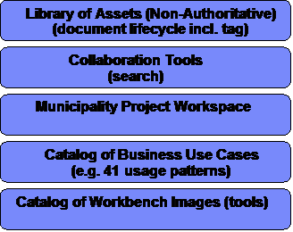

MISA Model Management
MyMunicipality2
MISA Authoritative Model Management & Admin (ITIL)
MyMunicipality1 Authoritative Model Management & Admin
Misa
MyMunicipality2
MISA
Meta Model
Meta Model
MRM V2
MyMunicipality1
My Municipality
Meta Model
Create/Update
My Municipality
Meta Model
Import (any)
MISA
Reference Model
Reference Model
MRM V2
My Municipality
Meta Model
Import
My Municipality
Baseline
Create/Update My Municipality
Municipality1
Model Governance
MISA Model
Governance
MISA Collaboration Workspace
Municipality 2
MISA Collaboration Mngt & Admin (ITIL)
Library of Assets (Non-Authoritative)
(document lifecycle incl. tag)
Municipality 1
Collaboration Tools
(search)
Project A
Municipality Project Workspace
Project B
Catalog of Business Use Cases
(e.g. 41 usage patterns)
Project C
Knowledge Workers
IT Service Mngt (ITIL)
Catalog of Workbench Images (tools)

Slide 19
MISA Delivery Platform Governance and Operations
Governance (MRM and Delivery Platform)
Subscriber (Municipalities) Lifecycle Management
MRM V2
MetaModel
Reference
Model
My Municipality
Baseline Instances
(authoritative)
Best Practice Asset Repository &
Workflow
Collaboration
Workspace
Design & Modeling Tool Provision
(Image & License Mngt)
Search, Query, Scripting, Reporting, Import & Export Capabilities
Application & Infrastructure Delivery Platform & Operations (eSolutions)
Municipality Platform Governance and Operations
Strategy & Planning
IT Architecture &
Design
Business
Operations
My Municipality
Model Mngt
Strategic
Intent & Priorities
Enterprise
Architecture
Executive
Dashboard
Administration
Business
Architecture
Solution
Architectures
BI & Analytics
Project
Support
Application/Service
Architecture
Mission
Performance
Arch & Model
Review Board
Build &
Test
Technical
Architecture
Financial
Performance
Meta
Modeler
Transition &
Roadmap
Operational
Performance
Reference
Modeler
Municipality Collaboration, Design & Content Mngt Platforms

Slide 20
MRMv2 Program – PROJECT Organization and Governance Structure
MISA / ASIM Canada
MISA Ontario
Steering Committee
Program Director
MRM V2 – Program
Program Advisor
Chartwell
Program Manager
Design Review Group
Software and Website
Program
Fund Raising
Program Sustainment
Marketing & Communications
Training
Implementation
Lead Municipality
Project Manager
Project Manager
Project Manager
Project Manager
Operating and Support Environment.
Data Population
Software Vendor
Chartwell
Test Municipalities
Project Manager
Project Manager
NOTE: Chartwell Acquired by KPMG in March 2009
Who will manage the delivery platform and subscriber lifecycle mngt?

Slide 21
Existing Tools
RSM for metamodel
  SysML model with export to ReqPro requirement types
ReqPro for reference and instance municipal models
  Matrix builder for editing relationships between entities
  Model compare
RRC to elaborate reference and instance models
  Rich text
  Business process, organization and use case diagrams
Lotus Quickr for collaboration
  Places setup for each municipality
  Ability to collaborate for review, approval and action on municipal transition initiatives
  Focus mostly on strategic planning in this phase

Slide 22
Tool Issues (current scope)
Complex, licensing initial tool and project setup
Challenges running rich client apps in a WAN
Limited or manual integration between tools
  Meta-model and instance model
  Model and rich text & graphics
  Model and collaboration environment
Lack of data validation on import
  Validation of model against meta-model
  Validation of model integrity
Limited support for model diagrams
Limited Reporting, Querying and Scripting
Notes:
See SDW Technical Challenges.doc

Slide 23
Future Requirements (beyond current scope)
Interface suitable for a non-technical user
Need for multi-classification for more flexible organization, easier search - consider
Need for financial planning and reporting system
Need for easy modification, lifecycle management and compare/merge
Connect objective metrics to operational systems for feedback and portfolio management
Low cost
Availability for Municipal Pilots
Notes:
Issues taken from various MISA presentations

Slide 24
Solution Issues
How to export from MISA tools into solution development tools
  Making the MISA models actionable
  Integration with down-stream Model-Driven solutions design, implementation and deployment
Reporting capabilities

Slide 25
Process Enablement
How to create initial municipal model
  Import CSV file from existing assets
  Use matrix editor to edit relationships
  Frameworks for model development and use
  Supporting guidebooks

Slide 26
Governance Issues
Lifecycle management of meta, reference and instance models
Data validation
Process enactment

Slide 27
Moving Forward – Key Requirements to Address:
Upstream Strategic Planning (what to do with the municipal models)
Downstream Connection to IT architecture (for solution design/development)
Lifecycle Management and Governance
Accessibility, consumability (install, license, update, WAN access, Web Access)
Cost

Slide 28
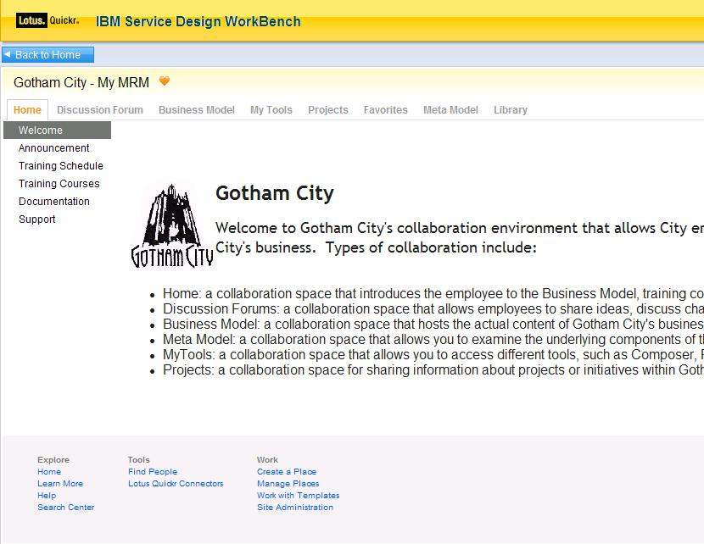
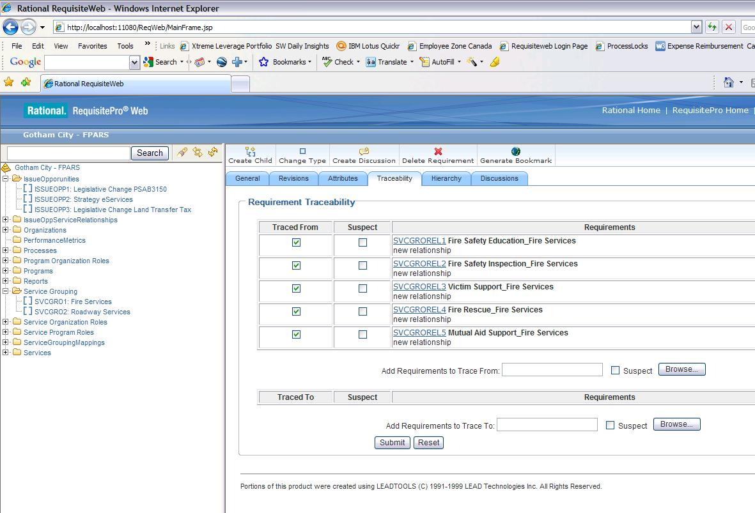
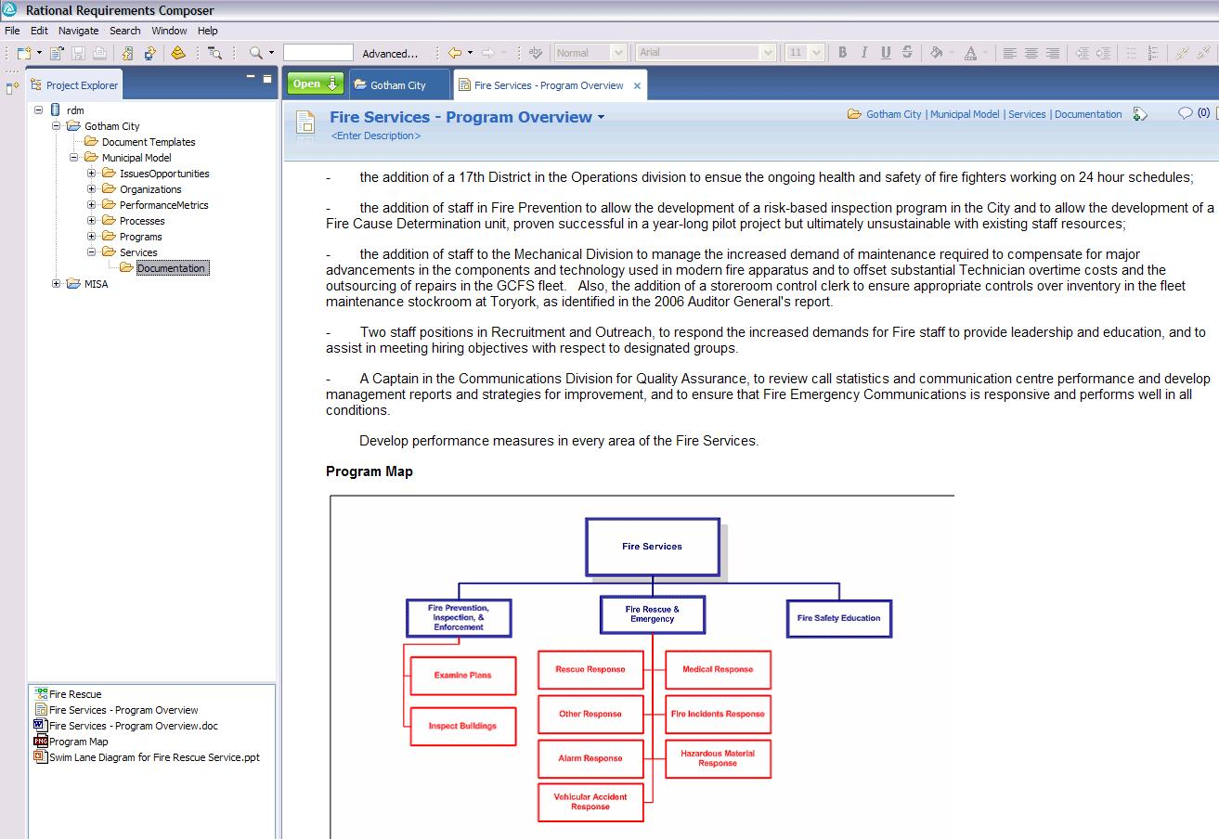
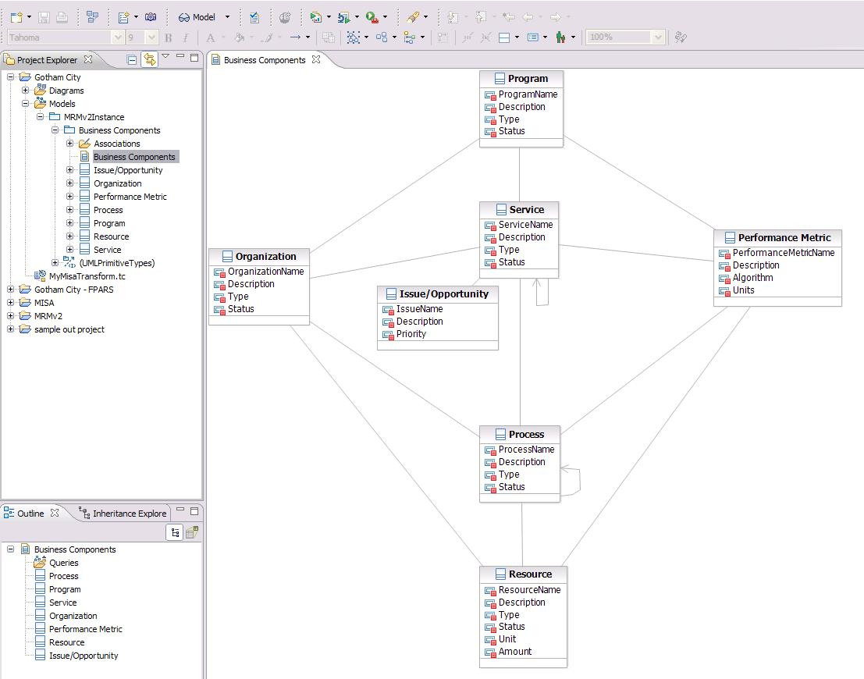
SDW Option 1: Evolve Current Tooling Architecture
Business User
Business Analyst
Meta Modeler
Rational RequisitePro
Rational Requirements Composer
Lotus Quickr
Rational Software Modeler
ReqPro
  Create & manage business components
  Build relationships between components
  Query business components
  Compare business components in one municipality or across municipalities
  Import/Export business component matrices
RRC
  Elaborate on business components with documents, BPM diagrams, UC diagrams
Review business component content published from ReqPro, RRC, RSM
Collaborate – forums, wikis
Create and extend MRM meta-model
Compare meta models (versions of one municipality or across municipalities)

Slide 29
SDW Option 1: Assessment
Address install, update, licensing with scripts or VM image clone
Address usability issues with convenience menu items and integration scripts
  Hide import/export with “edit/save” where possible
Solution is available for pilot now
But this is not a strategic solution
  Doesn’t address lifecycle management
  Doesn’t support strategic planning
  Not well positioned for EA or solution design/delivery
  High dependency on tooling that is not designed for modeling

Slide 30
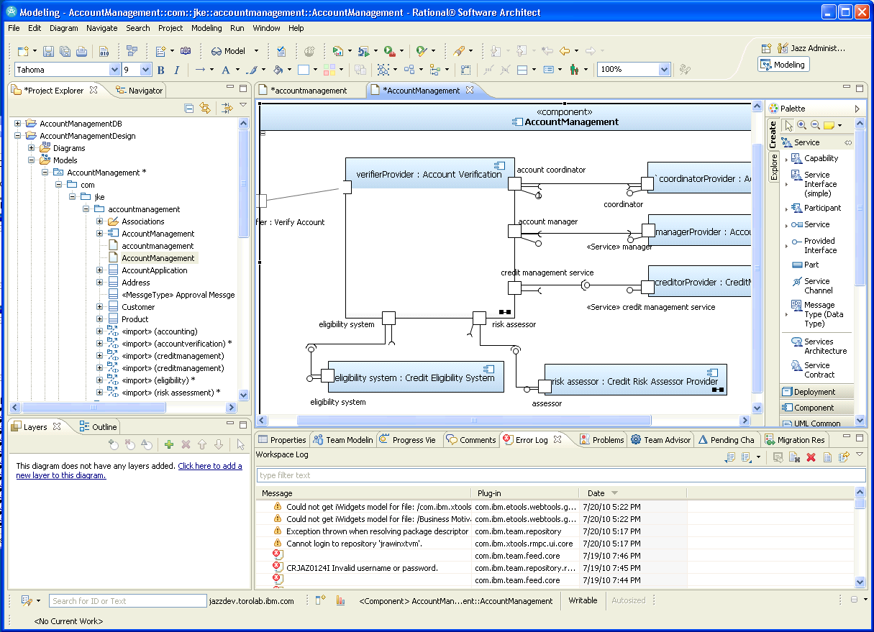
SDW Option 2: Tooling Architecture based on RSx - Triton
Business User
Business Analyst
Meta Modeler
Lotus Quickr
Rational Software Modeler, (CAM), RAM, RPE
Rational Software Modeler
  Create & manage business components
  Build relationships between components
  Query business components
  Compare business components in one municipality or across municipalities
  Import/Export business component matrices
  Elaborate on business components with documents, BPMN diagrams, UC diagrams
Review business component content published from RSx
Collaborate – forums, wikis
Create and extend MRM meta-model
Compare meta models (versions of one municipality or across municipalities)

Slide 31
SDW Option 2: Assessment
Do meta-model using UML profile
  Generate tooling UI from UML profile
Instance model is a UML model with applied profile
  Can exploit SysML and/or SoaML for services modeling, BMM for business motivation and strategy
  BIRT and Insight for reporting
  Similar solution for matrix/spreadsheet editing
  Direct support for diagrams and rich text documents
  Integration with WebSphere Business Modeler
Mostly single tool solution but with limited Web UI
  RSx 8 and CAM 3.0 provide read-only web access and review, markup and commenting
Good solution if downstream IT development and deployment is primary value proposition

Slide 32
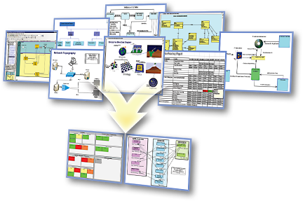
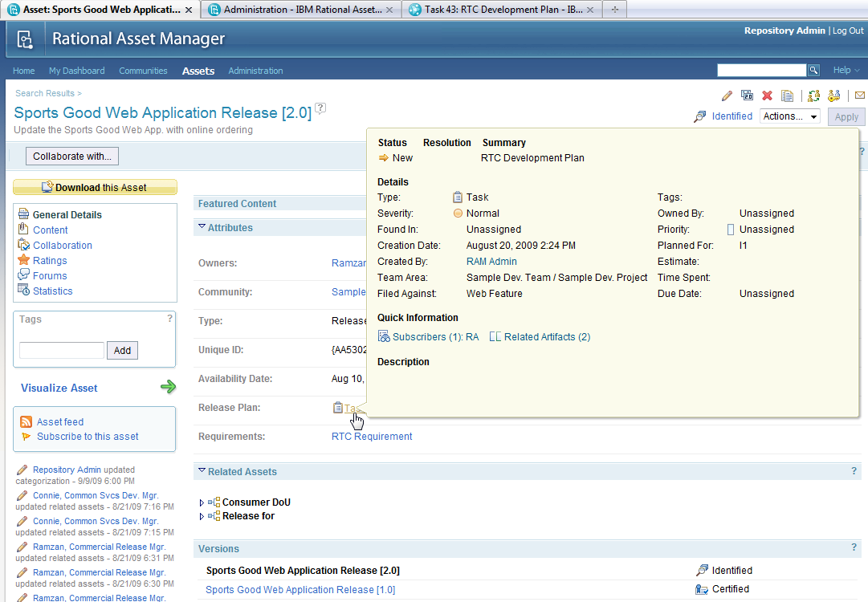
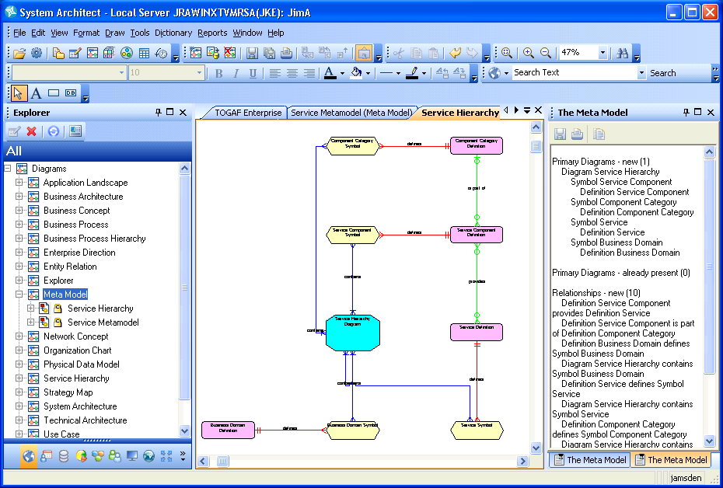
SDW Option 3: Rational System Architect
Business User
Business Analyst
Meta Modeler
Rational System Architect, SA/XT, RAM, RPE
Rational System Architect Extensibility
Lotus Quickr
  Create & manage business components
  Build relationships between components
  Query business components
  Compare business components in one municipality or across municipalities
  Import/Export business component matrices
  Elaborate on business components with documents, BPMN diagrams, UC diagrams
Review business component content published from SA
Collaborate – forums, wikis
Create and extend MRM meta-model
Compare meta models (versions of one municipality or across municipalities)

Slide 33
SDW Option 3: Assessment
Meta-model and models are in a single tool
Supports lifecycle management through workspaces
Integrates with Focal Point for strategic planning
Integrates with Cognos for Business Intelligence
Supports explorer, data forms, diagram and matrix views
SA/XT provides Web interface with limited editing capability
Powerful, flexible query mechanism, explorer diagrams and reporting
Highly customizable for stakeholder viewpoints
Supports model compare/merge
Provides support for enterprise architecture including business and IT architecture for solution design
Good solution if strategic planning is the primary value proposition
Notes:
+ SA has a rich client UI, and a Web UI using SA/XT that also supports model editing
+ SA supports integrated explorer, data entry form, diagram and matrix views on model data as well as free-form views
+ SA provides rich, extensible matrix views and additional views can be created by end users in support of particular stakeholder needs
+ SA is highly customizable even by end users (for opportunistic metamodel extensions)
+ SA has a powerful, flexible query mechanism
+ The supporting tool set is resulting in the installation of less tools (SA and SA/XT)
+ Information is integrated into a single repository accessed by different tools reducing lifecycle management burden and costs
+ Lifecycle management is supported by workspaces and compare merge of model content
+ Information redundancy can be managed as needed
+ The MRM business motivation and strategy, and business architecture parts of EA can be easily extended or integrated with other content and capabilities to support the rest of the EA (application, data and technical architectures) for the next phase of use cases
- Editing the metamodel with SA USERPROPS is not as easy as editing a UML model. This may be inproved in 11.4.1 with the introduction of a metmodel editor extension to visually create the metamodel extensions. (That capability may be available for internal use now).
+ Metamodel extensibility includes support for explorers, forms, matrixes, diagrams and reports, not just the metamodel classes
+ SA has a number of different reporting options that can be used
+ SA/XT can be integrated with Quickr to provide collaboration on live MRM data, not just published, potentially stale data
- SA rich client UI may not be appropriate for many business analysts and SA/XT has limited editing capabilities
+ SA integration with Focal Point would provide a capability to objectively analyze different MRM project alternatives
+ Some elements of the existing SA TOGAF and/or TeamSD metamodels could be used to enhance and extend the existing MRM metamodel and tools, as well as address more of the MRM business use cases.
- No support for sketching and storyboards directly in SA

Slide 34
Addressing the Issues
Issue | Addressed By
Complex, licensing initial tool and project setup | Reduction in number of tools. SA replaces RSM, ReqPro and RRC
Challenges running rich client apps in a WAN | Same problem with all options. SA runs in Remote Desktop Connection with floating license
Limited or manual integration between tools Meta-model and instance model Model and rich text & graphics Model and collaboration environment | All models in SA. SA extensibility used to update metamodel. SA and SA/XT used to view and edit models. Uses SA browser, definitions, diagrams, matrices, explorer diagrams
Lack of data validation on import | Eliminate as much as possible import/export as a means of integrating tools
Limited support for model diagrams | SA has support for many standard diagrams, explorer diagrams (from reports) and can have custom diagrams
Limited Reporting, Querying and Scripting | SA supports queries, HTML and Office reports, SA Publisher, Insight and Cognos reporting, and RPE

Slide 35
Addressing the Issues (cont.-)
Issue | Addressed By
Interface suitable to different stakeholders | SA rich client for business architect, SA/XT for business architect and user, Quickr for collaboration
Support for flexible classification | SA supports categorization of model elements, and/or use RAM
Strategic Planning | SA integration with Focal Point provides: Project Portfolio Management Strategic alignment with business objectives Assessment of costs, risks, NPV, time to value Project roadmaps and resource allocation
LIfecycle Management | SA has versioning for definitions, and workspaces for different work streams. Supports compare and merge to manage changes. RAM for asset management and governance
Cost | Incremental difference in cost for each solution option. Actual cost depends on potential use of Cloud subscription model. Needs further investigation
Availability | Existing solution would need to be migrated to chosen option

Slide 36
Appendix

Slide 37
MISA Delivery Platform Governance and Operations
Governance (MRM and Delivery Platform)
CloudBurst
Subscriber (Municipalities) Lifecycle Management
SA
SA
Quickr
Quickr
MRM V2
MetaModel
Reference
Model
My Municipality
Baseline Instances
(authoritative)
Best Practice Asset Repository &
Workflow
Collaboration
Workspace
Design & Modeling Tool Provision
(Image & License Mngt)
SA
RAM
SA pub
(RPE)
Search, Query, Scripting, Reporting, Import & Export Capabilities
Application & Infrastructure Delivery Platform & Operations (eSolutions)
Municipality Platform Governance and Operations
Strategy & Planning
IT Architecture &
Design
Business
Operations
My Municipality
Model Mngt
SA/XT
Focal
Point
Strategic
Intent & Priorities
SA
Enterprise
Architecture
Executive
Dashboard
Administration
SA
Cognos &
SPSS
Project
Support
Business
Design
Solution
Architectures
BI & Analytics
Focal
Point
Rational
Mission
Performance
Arch & Model
Review Board
Transition &
Roadmap
Build &
Test
RAM
Financial
Performance
Meta
Modeler
SA
Operational
Performance
Reference
Modeler
Municipality Collaboration, Design & Content Mngt Platforms

